Slide 1
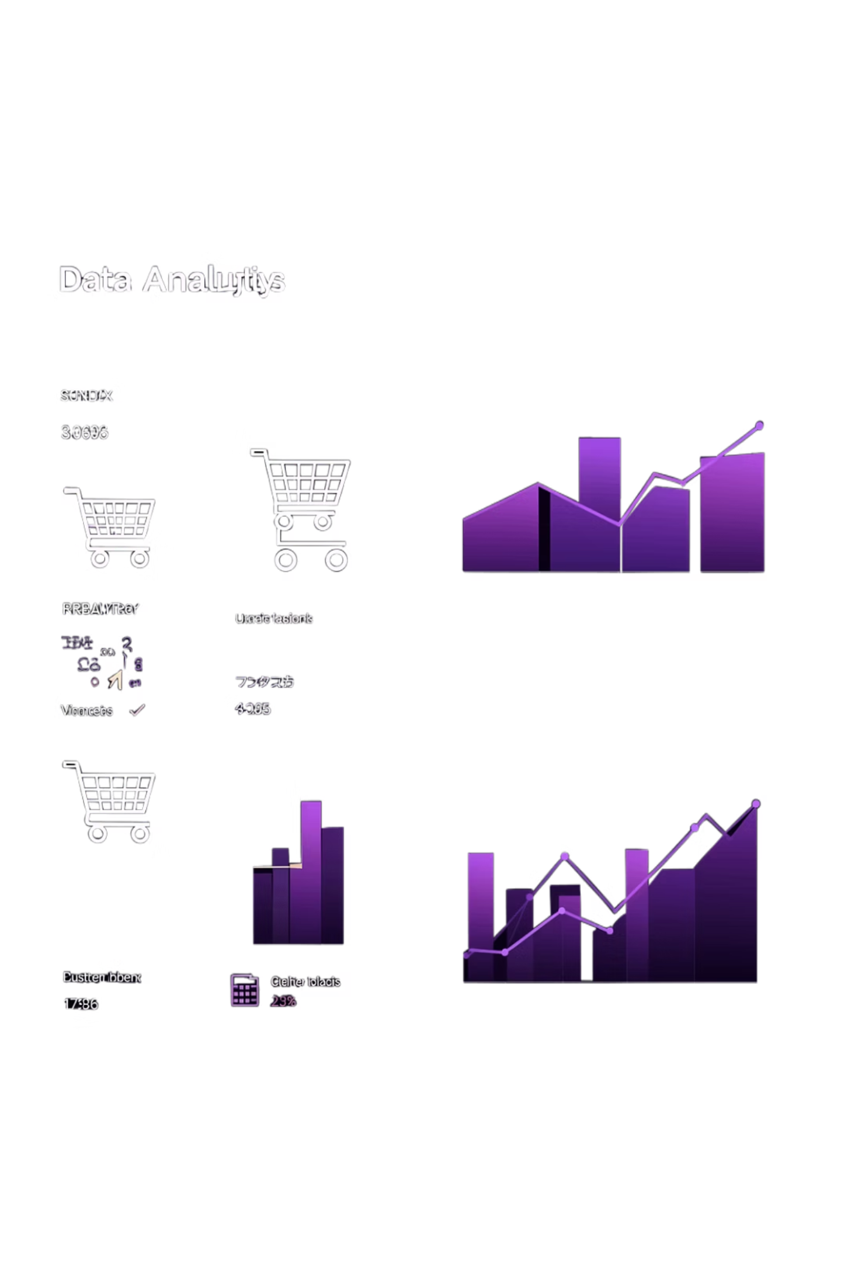
Customer Shopping Behavior Analysis
Uncovering insights from 3,900 purchases to guide strategic business decisions

Slide 2

DATASET OVERVIEW
The Foundation
3,900
18
50
$59.76
Total Purchases
Data Points
Locations
Avg Purchase
Transactions analyzed
Features per customer
Geographic coverage
Per transaction
Key features: demographics, purchase details, shopping behavior, and review ratings

Slide 3

PYTHON ANALYSIS
Data Preparation & Cleaning
01
Data Loading
Imported dataset, explored structure
02
Missing Data
Imputed 37 review ratings by category median
03
Feature Engineering
Created age groups, purchase frequency metrics
04
Database Integration
Loaded cleaned data into PostgreSQL

Slide 4
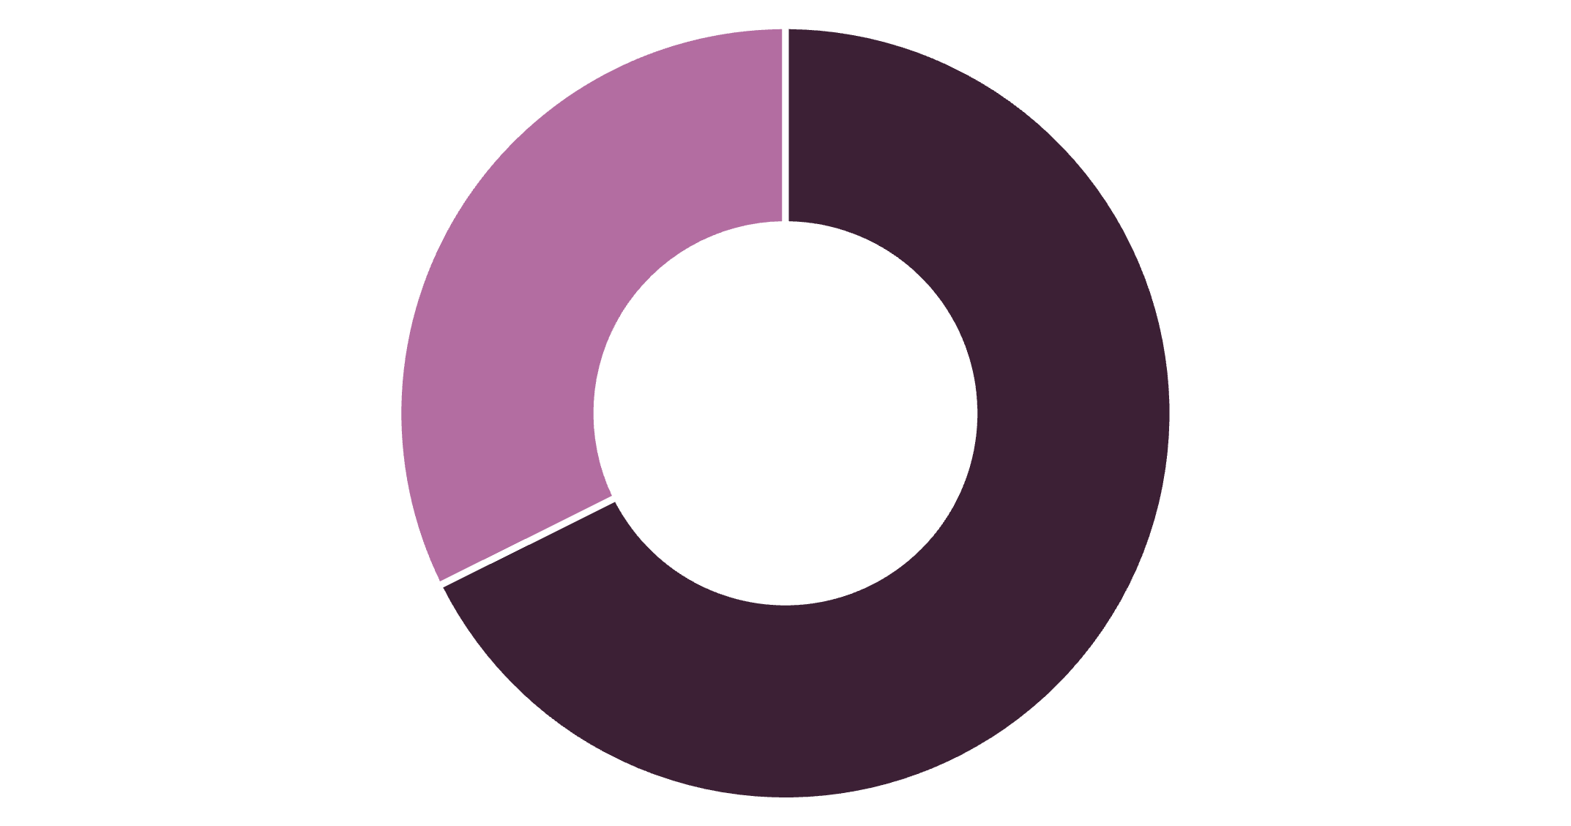
SQL INSIGHTS
Revenue by Gender
Male Customers Drive Revenue
Male customers generate 68% of total revenue despite representing 68% of customer base
Total Revenue: $233,081
Understanding gender-based purchasing patterns enables targeted marketing strategies
Male
Female

Slide 5


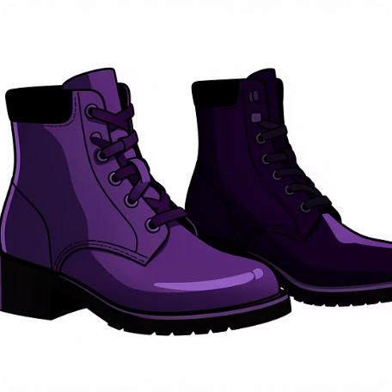

Top Performing Products
Gloves
Sandals
Boots
Hat
Highest rated: 3.86 stars
Second best: 3.84 stars
Strong performer: 3.82 stars
Customer favorite: 3.80 stars

Slide 6

Customer Segmentation Insights
Loyal Customers
3,116 customers
80% of customer base
Returning
701 customers
18% showing repeat behavior
New
83 customers
2% first-time buyers
Strong loyal customer base presents opportunity for subscription conversion and retention programs

Slide 7
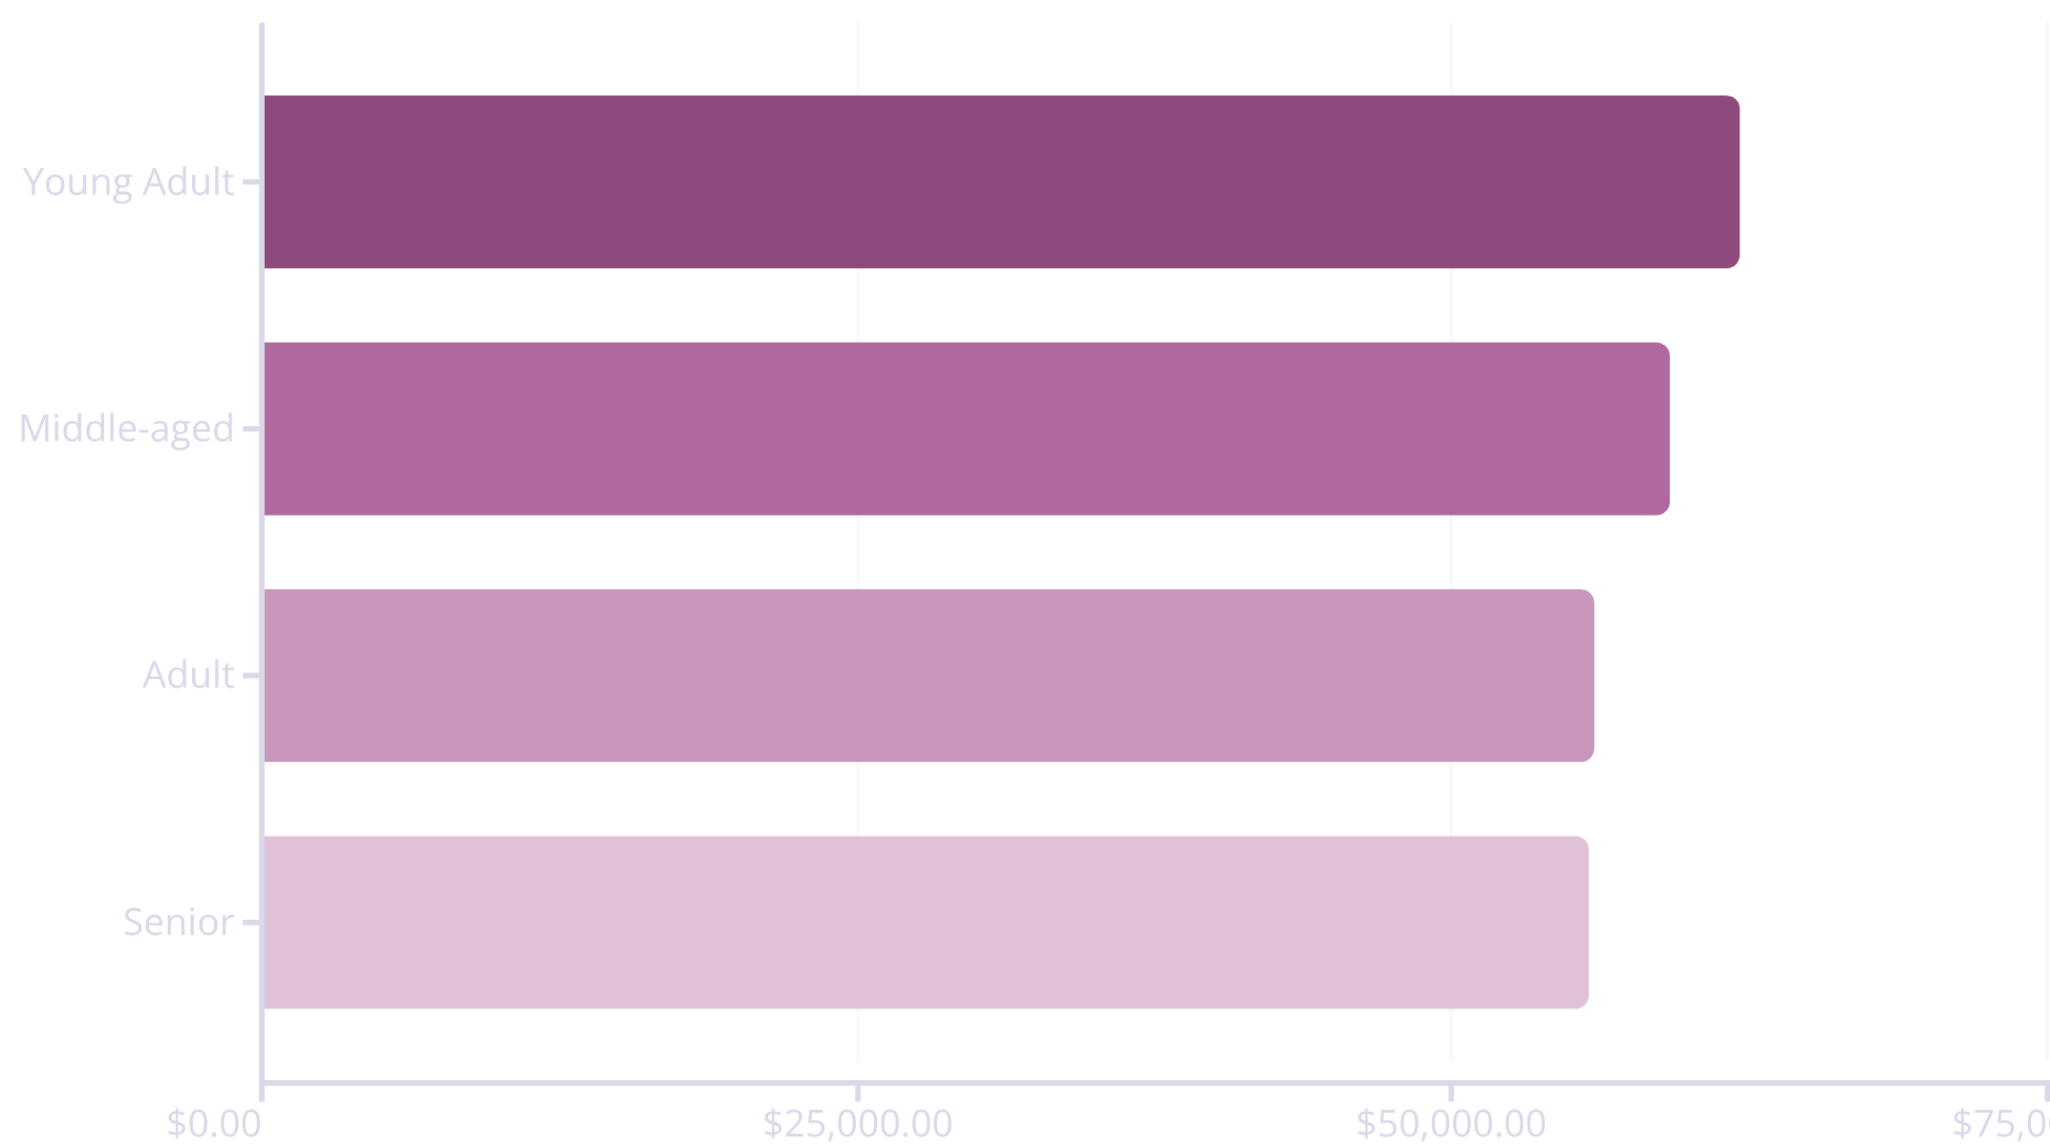
AGE DEMOGRAPHICS
Revenue by Age Group
Balanced Distribution
Young adults lead revenue generation at $62K, but all age groups contribute relatively evenly
Opportunity for age-specific marketing campaigns and product positioning

Slide 8
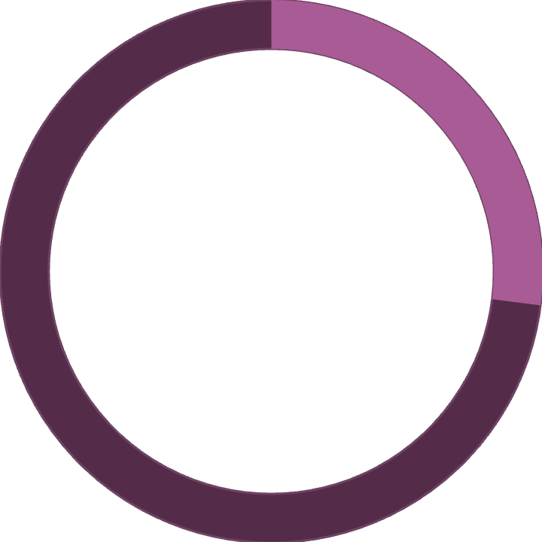

Subscription Status Analysis
27%
73%
Subscribers
Non-Subscribers
1,053 customers
2,847 customers
Key Findings
Subscribers: $59.49 avg spend, $62,645 total revenue
Non-subscribers: $59.87 avg spend, $170,436 total revenue
958 repeat buyers (>5 purchases) are subscribers
2,518 repeat buyers remain unsubscribed
Opportunity: Convert repeat buyers to subscription model

Slide 9

Power BI Dashboard
Category Performance
Customer Metrics
Interactive Filters
Clothing leads with $100K revenue and 1,800 sales
3.75 average rating across all products
Slice by subscription, gender, category, shipping type

Slide 10




STRATEGIC RECOMMENDATIONS
Business Action Plan
Boost Subscriptions
Loyalty Programs
Promote exclusive benefits to convert 2,518 repeat buyers
Reward system to move returning customers to loyal segment
Targeted Marketing
Product Positioning
Focus on young adults and express shipping users
Highlight top-rated items: gloves, sandals, boots

